Slide 1

ESPARTA
Client : Dr. Mark Chai
Ajay Kumar Dhonthoju
Sahithi Kasarapu
Sailaja Lakkakula
Varsha Kalvakuntla
Manoj Thella
Sai Chaitanya Vishnu Kanth Inavolu

Slide 2
Outline
Seller and Customer login capabilities; sellers upload art with pricing, customers explore and purchase artworks.
User identification, art upload and display, price control, and secure purchase capabilities are key components.

Slide 3

Introduction
ESPARTA is all about artists arts and customers and sellers.
It focuses on bridging the gap between artists and people who buy the art.
The main aspects lies with ARTISTS, CUSTOMERS(Buyers), ARTWORKS, TRANSACTIONS.
"ESPARTA" have the potential to bridge this gap and empower artists to reach their full potential.

Slide 4
Problem Statement
“ESPARTA" focuses on the problems of the artists. It is concerned about the challenges artists face in effectively communicating with and reaching their customers that have been a persistent issue in the art world.
This problem has led to many talented individuals abandoning their artistic pursuits in favor of more stable careers. One of the primary problems artists encounter is the absence of a centralized space to display their creations as traditional art galleries are often limited in their capacity.
In addition, Buyers are often hesitant to invest in artwork without a secure way to verify its authenticity and provenance.
The communication gap between artists and potential buyers, along with the absence of a reliable and efficient platform to showcase and sell their work, has led to numerous challenges.

Slide 5
Use Cases
Use Case 1: Artist Registration Goal: As a new artist user, I want to register for an account on ESPARTA to showcase my artwork.
Use Case 2: Customer Registration Goal: As a new buyer user, I want to register for an account on ESPARTA to browse and purchase artwork.
Use Case 3: User Login Goal: As a registered user, I want to log in to my ESPARTA account to access my profile and use platform features.
Use Case 4: Artwork Upload Goal: As an artist user, I want to upload images of my artwork to showcase them on ESPARTA.
Use Case 5: Search for Artwork Goal: As a buyer user, I want to search for artwork on ESPARTA based on various criteria.
Use Case 6: Add Artwork to Cart Goal: As a customer user, I want to add artwork to my shopping cart for potential purchase.
Use Case 7: Purchase Artwork Goal: As a buyer user, I want to complete the purchase of artwork in my shopping cart.
Use Case 8: Order Management Goal: As a customer user, I want to manage the orders of artwork in my history.
Use Case 9: Messaging Artists Goal: As a user (artist or customer), I want to send messages to artists for inquiries or negotiations.
Use Case 10: User- Tracking System Goal: As the order is delivered to the customer, the customer would be able to receive the notifications and track their shipping status and expected dates of delivery.

Slide 6

Functional Requirements
The system shall or may allow the following tasks as below:-
Allow the artists to register for an account.
Buyers to register for an account.
User profiles for artists and buyers.
Artists to upload images of their artwork.
Search feature allowing users to find artwork.
Buyers to add artwork to their shopping cart.
Secure online payments for purchased artwork.
Messaging system for communication between artists and buyers.
Reporting mechanism for inappropriate content & user behavior.

Slide 7
Non Functional Requirements
The system MAY implement a virtual reality (VR) or augmented reality (AR) feature to view artwork in a simulated gallery setting.
The system MAY incorporate an art auction or bidding system for select artwork.
The system MAY allow artists to offer limited edition prints of their artwork.
The system MAY integrate with third-party shipping services for artwork delivery.
The system MAY offer an offline mode for users to browse and save artwork without an internet connection.

Slide 8
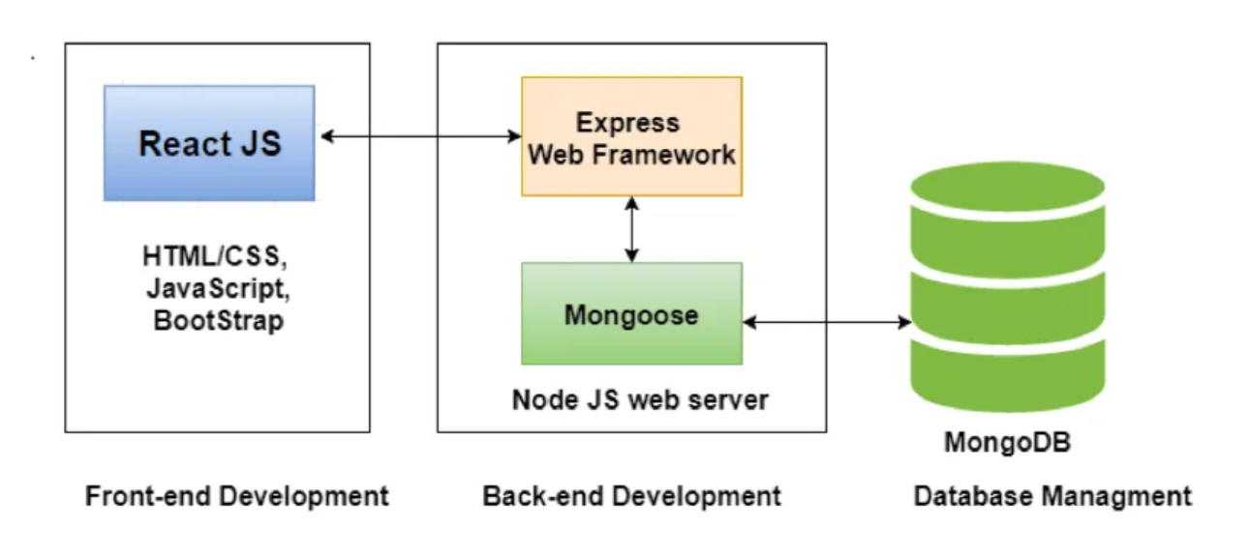
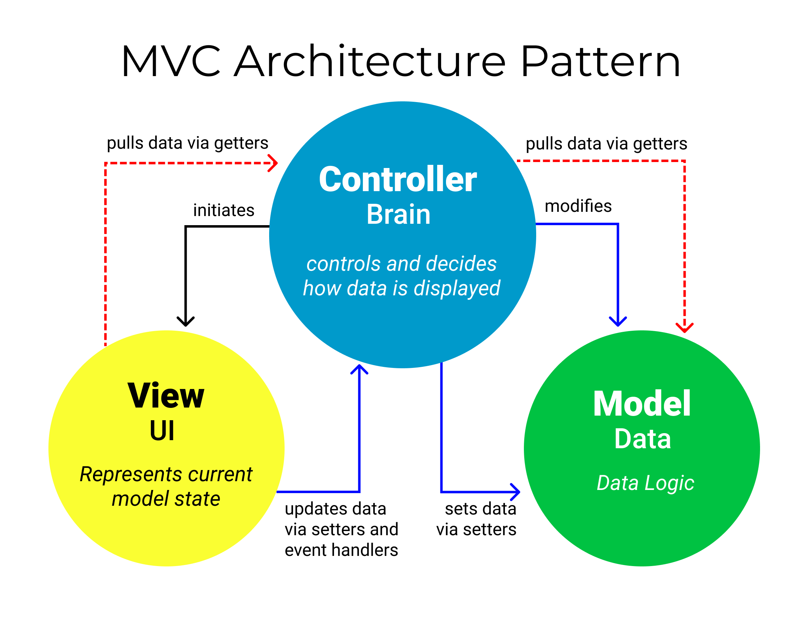
Architectural Plan

Slide 9





REACT BOOTSTRAP

Slide 10

Data Management Plan
Artists
Artist ID
Customers
Artwork
Name
Email
Image
Password (hashed)
Address
Artwork uploaded by the artist
Customer ID
Name
Email
Image
Password (hashed)
Purchased artworks
Address
Artwork ID
Artist ID (foreign key)
Title
Description
Price
Genre
Image URL(s)
Upload date
Transactions
Transaction ID
Buyer ID (foreign key)
Artwork ID (foreign key)
Purchase date
Payment details (encrypted)

Slide 11
Data Management Plan continued…
User Registration (Functional Requirement) Data Storage: Store user information (name, email, hashed password) in the respective collections (artists/buyers).
Artwork Upload (Functional Requirement) Data Storage: Save artwork details (title, description, price, genre) and associate them with the respective artist in the artwork collection.
Search for Artwork (Functional Requirement) Data Storage: Utilize MongoDB queries to search and filter artwork based on user criteria.
Add Artwork to Cart (Functional Requirement) Data Storage: Maintain a shopping cart for each buyer, storing selected artworks.
Purchase Artwork (Functional Requirement) Data Storage: Record transactions, associating the buyer and purchased artwork, and store payment details securely.
Messaging Artists (Functional Requirement) Data Storage: Implement a messaging system, storing messages with references to the sender, receiver, and associated artwork.
Provide Feedback and Ratings (Functional Requirement) Data Storage: Capture user feedback and ratings, associating them with the respective artwork or artist.

Slide 12
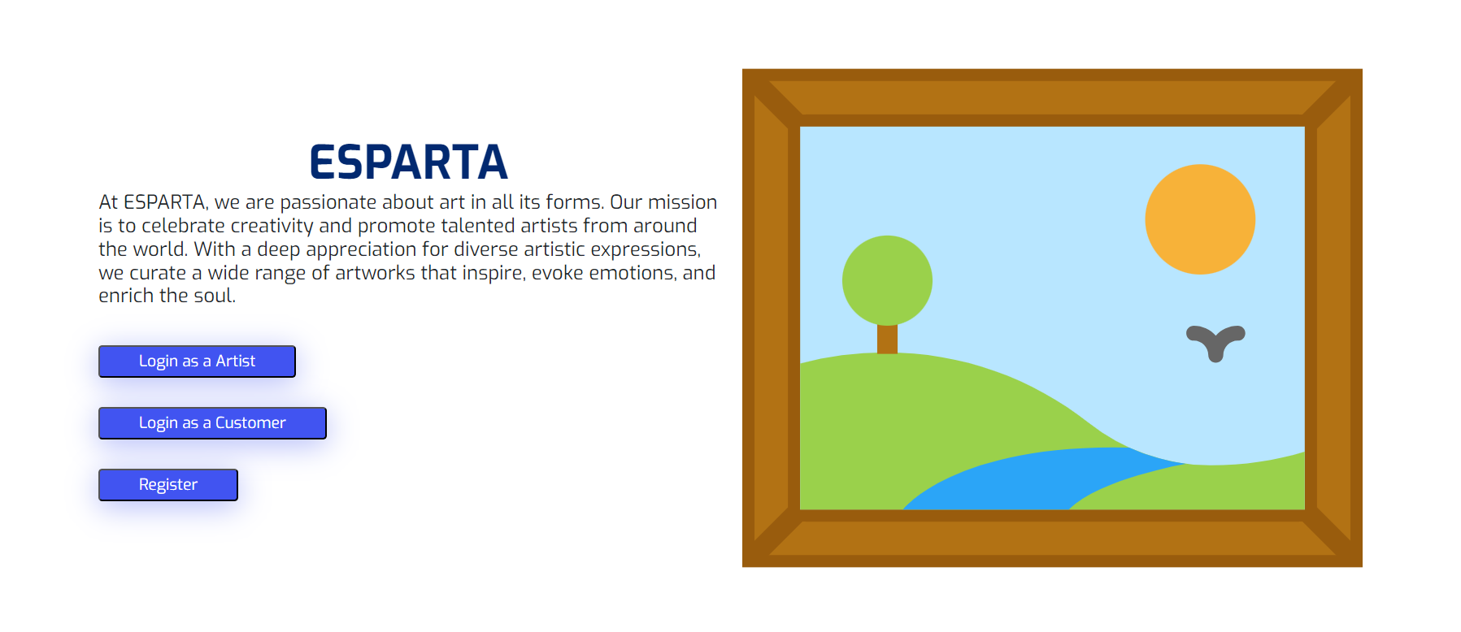
Prototype Demos
LANDING PAGE

Slide 13
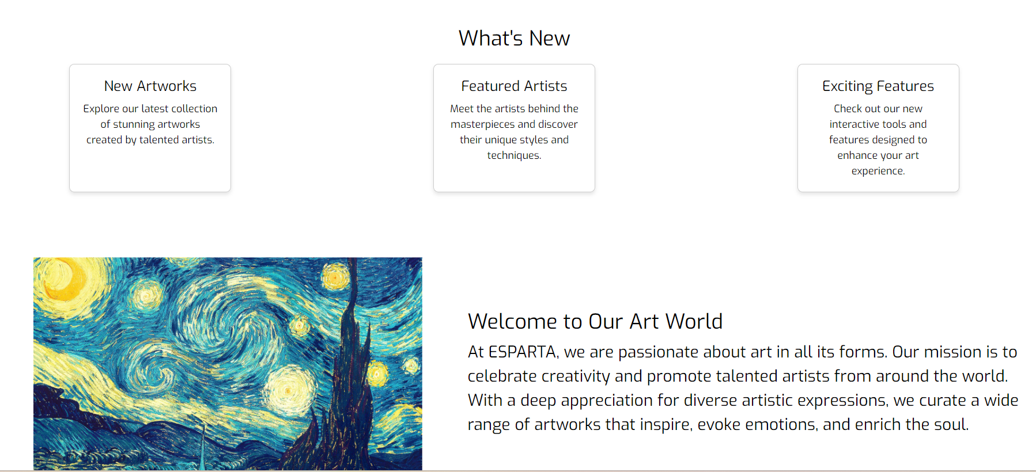
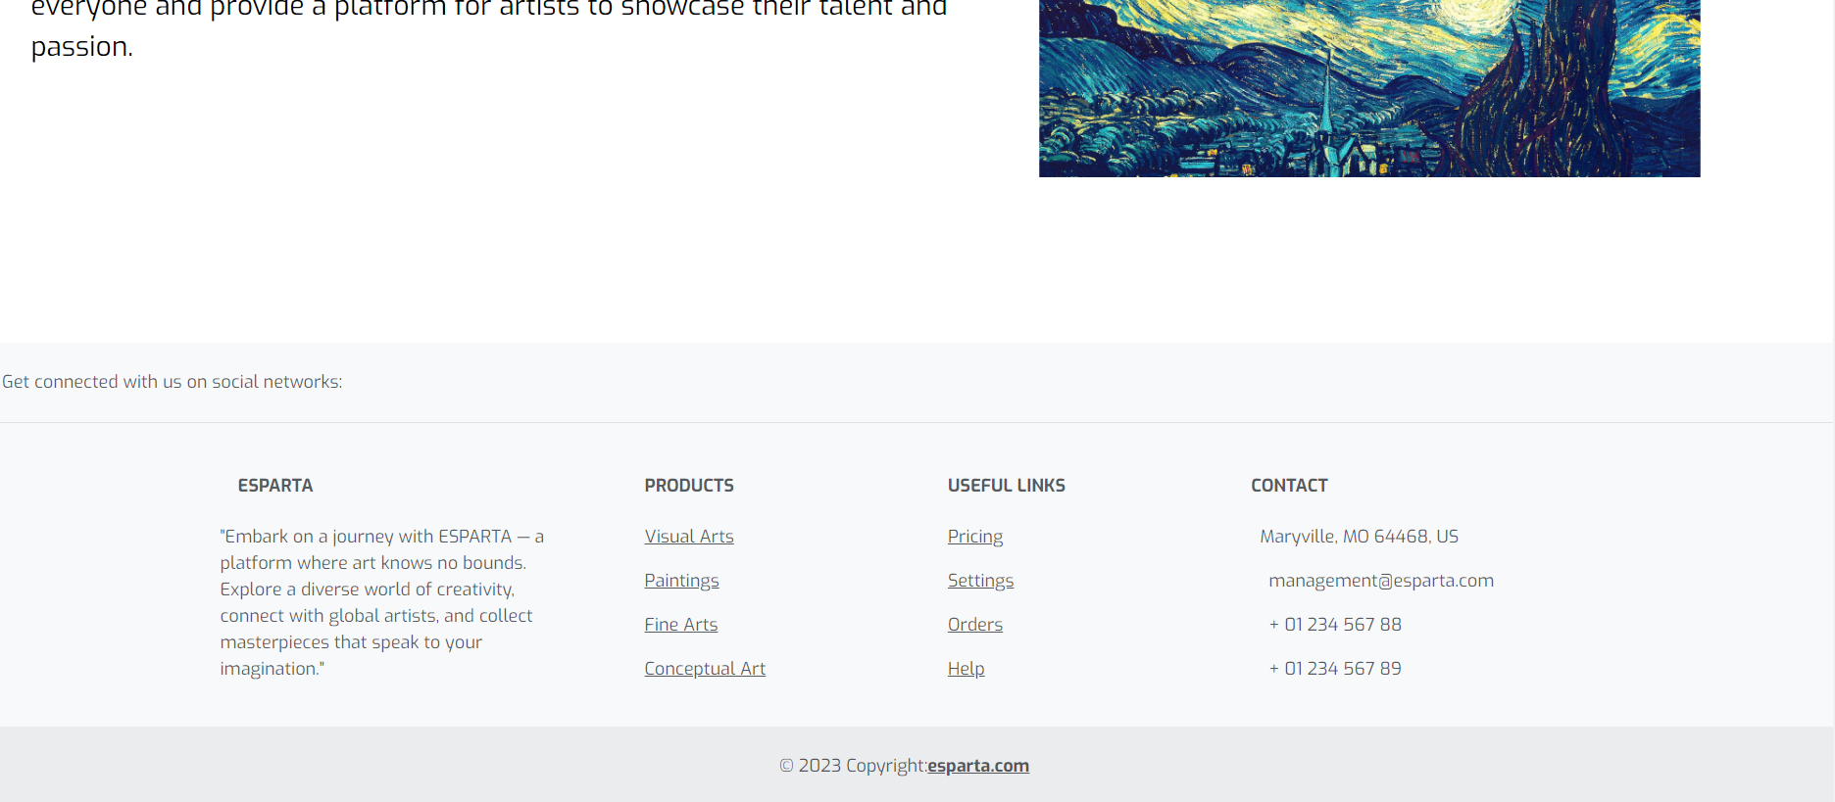

Slide 14
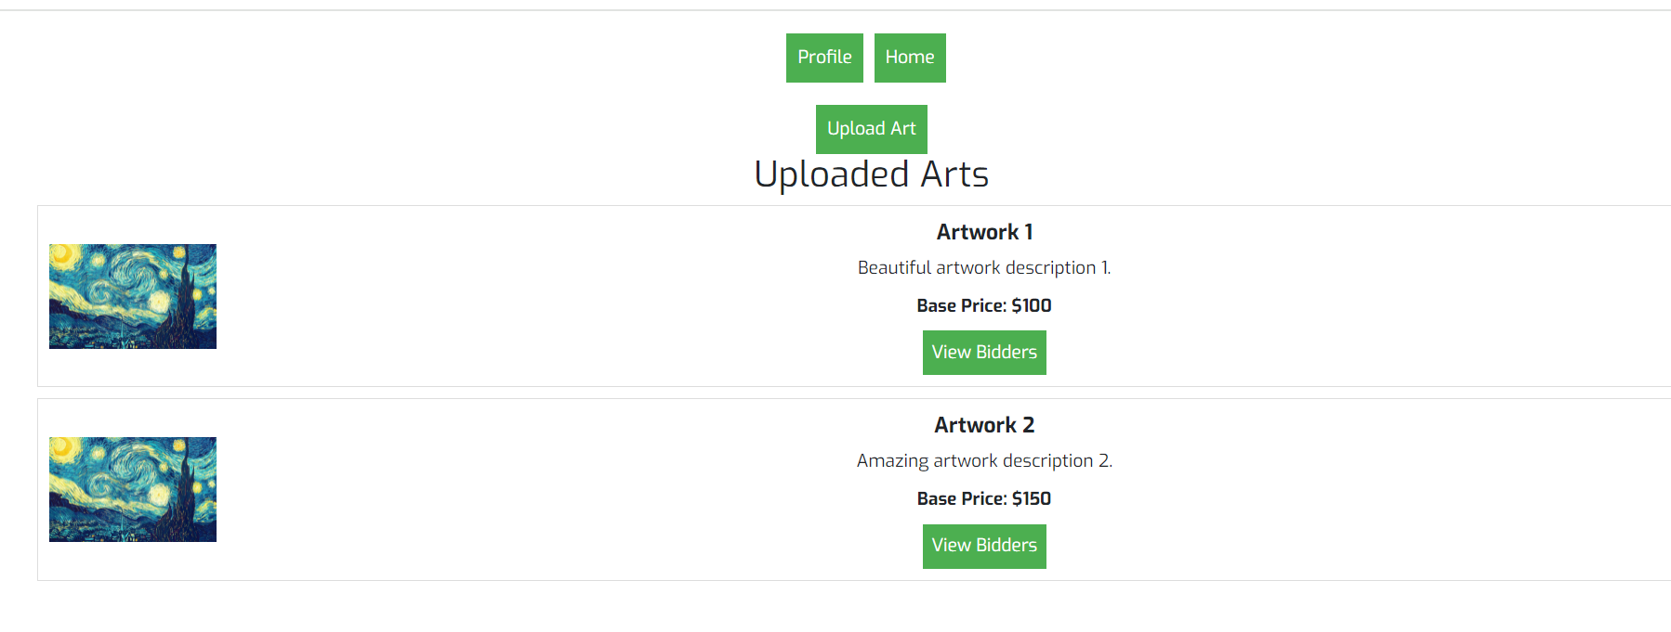
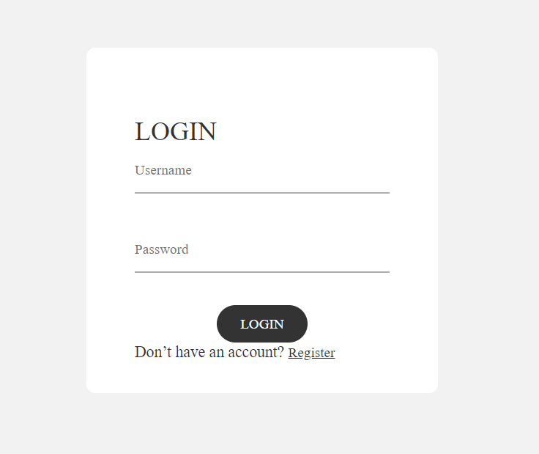
Artist Page After Login
Login Page for both Artist & Customer

Slide 15
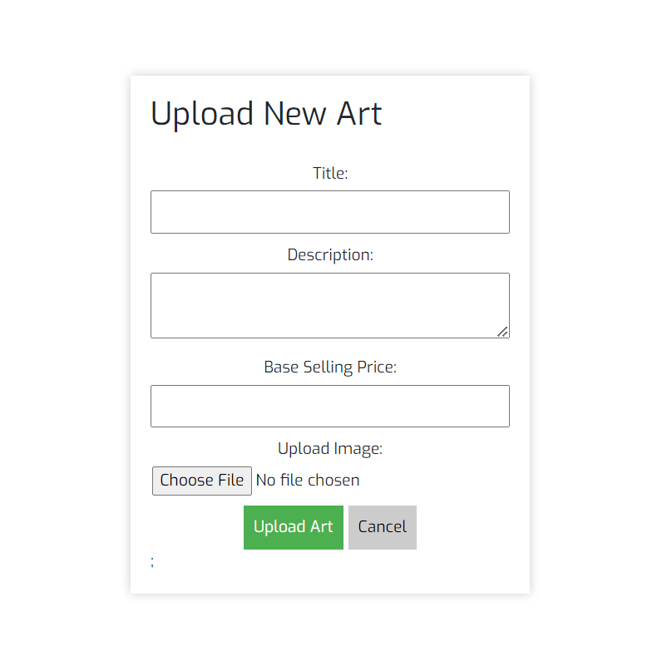
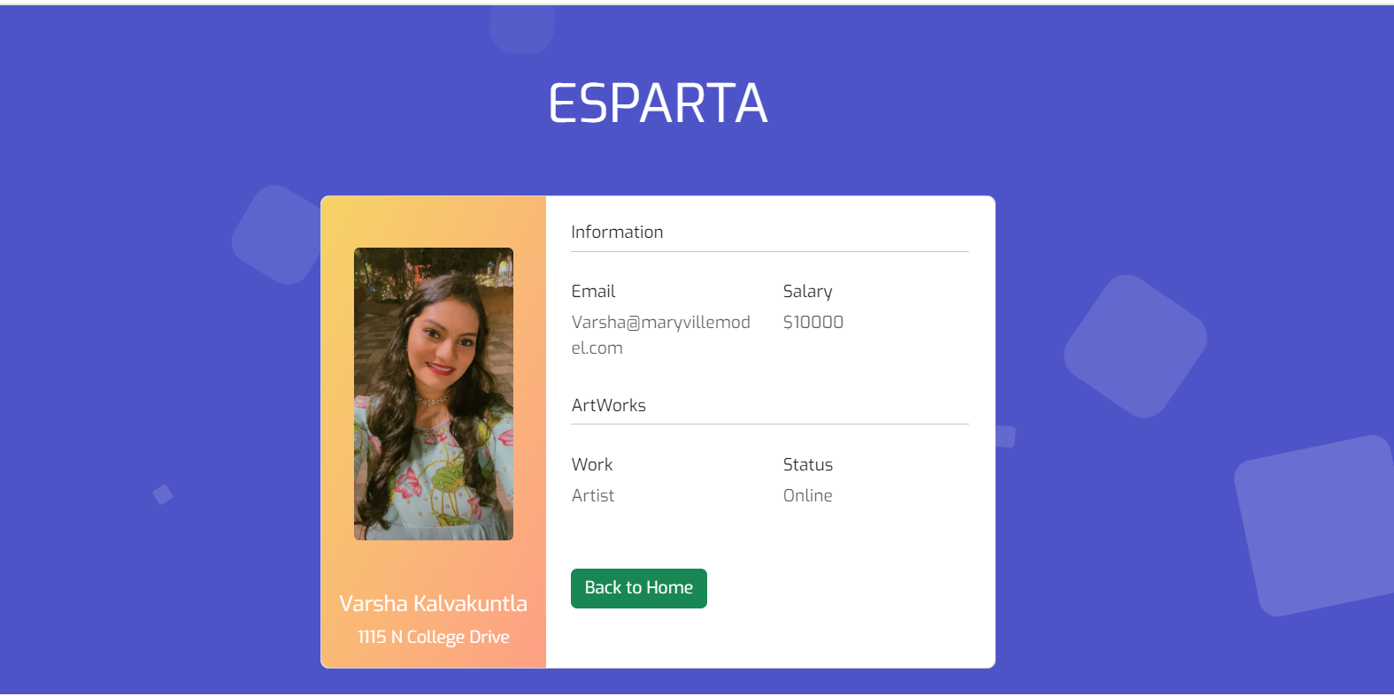
Artist Profile Page & Customer Profile Page
ART Upload Interface

Slide 16
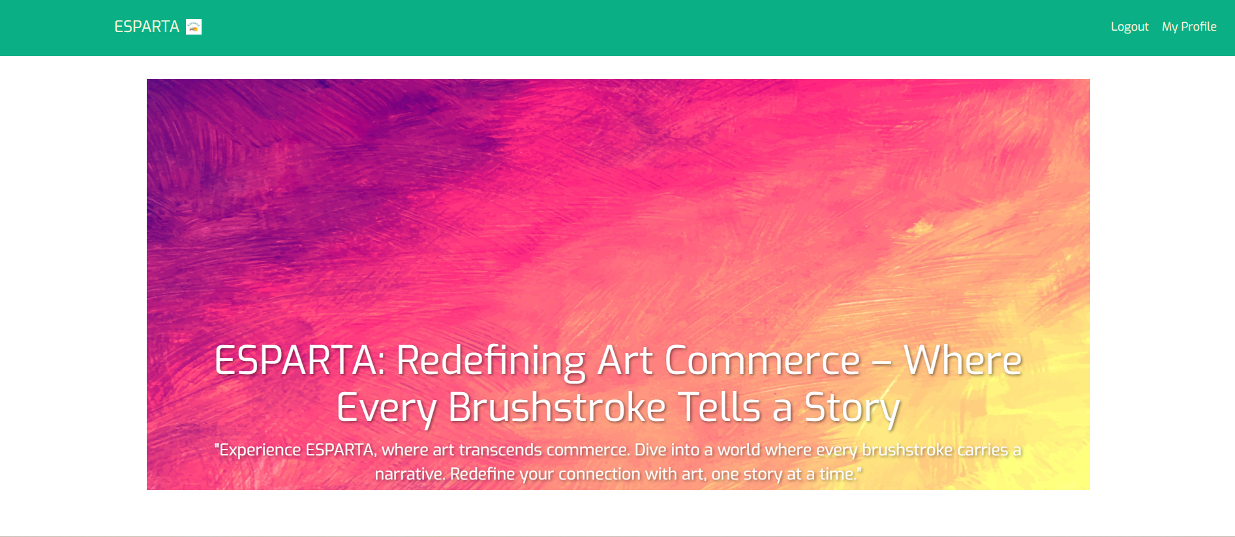
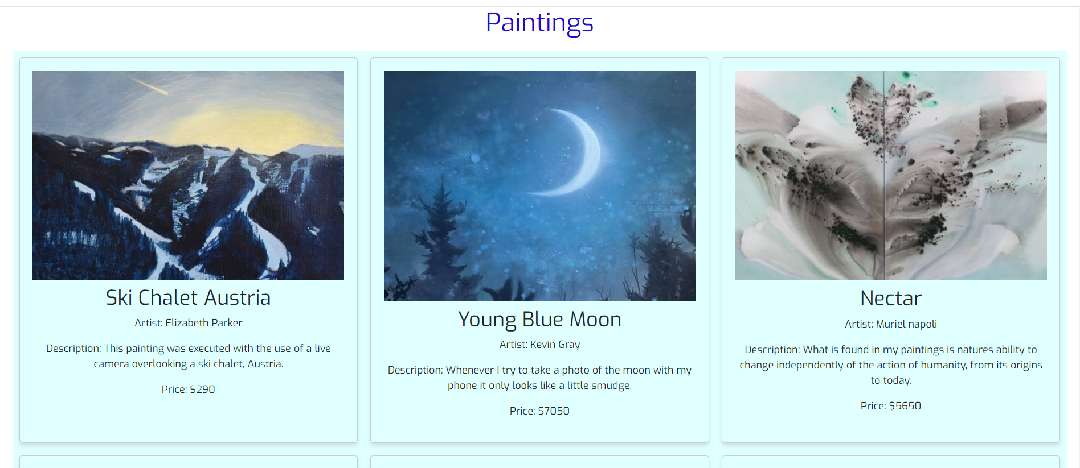
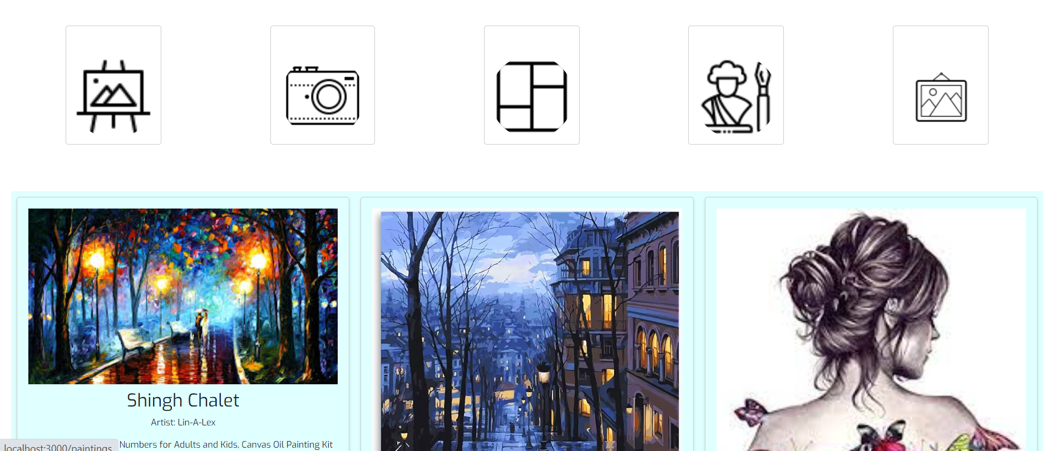
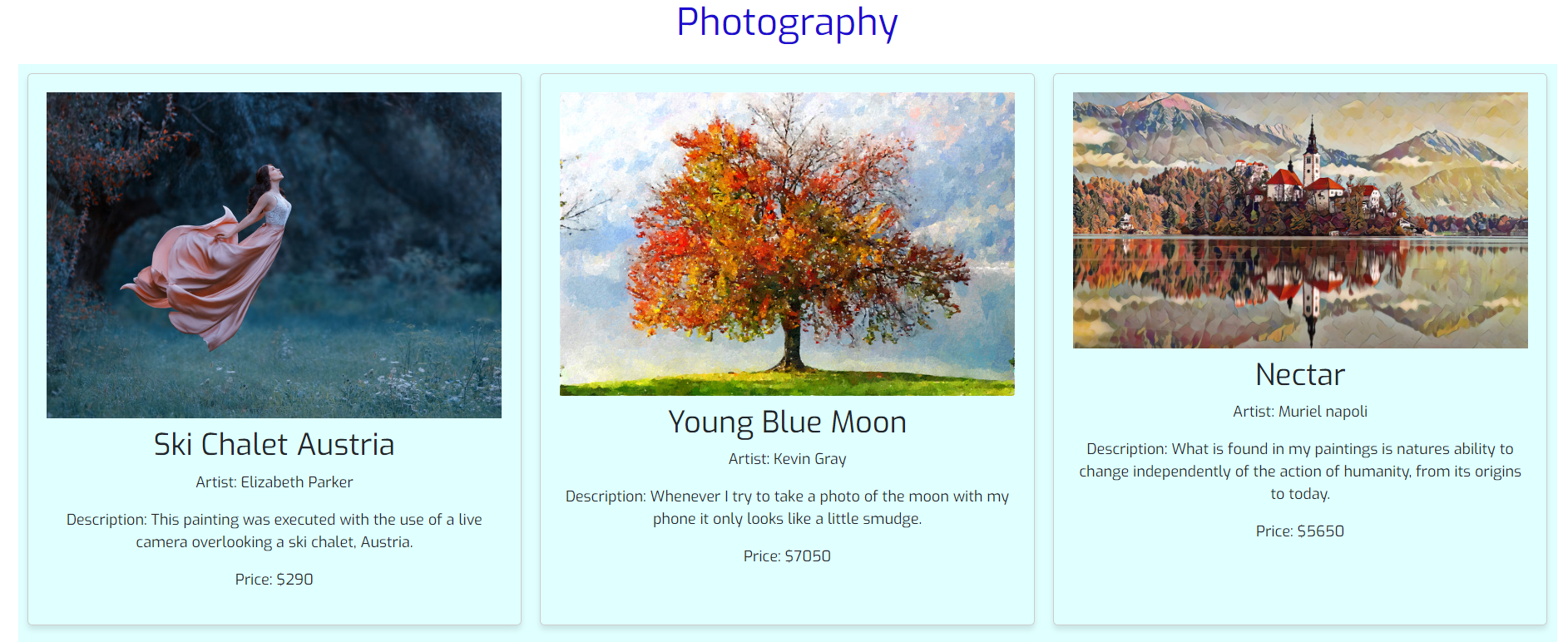

Slide 17
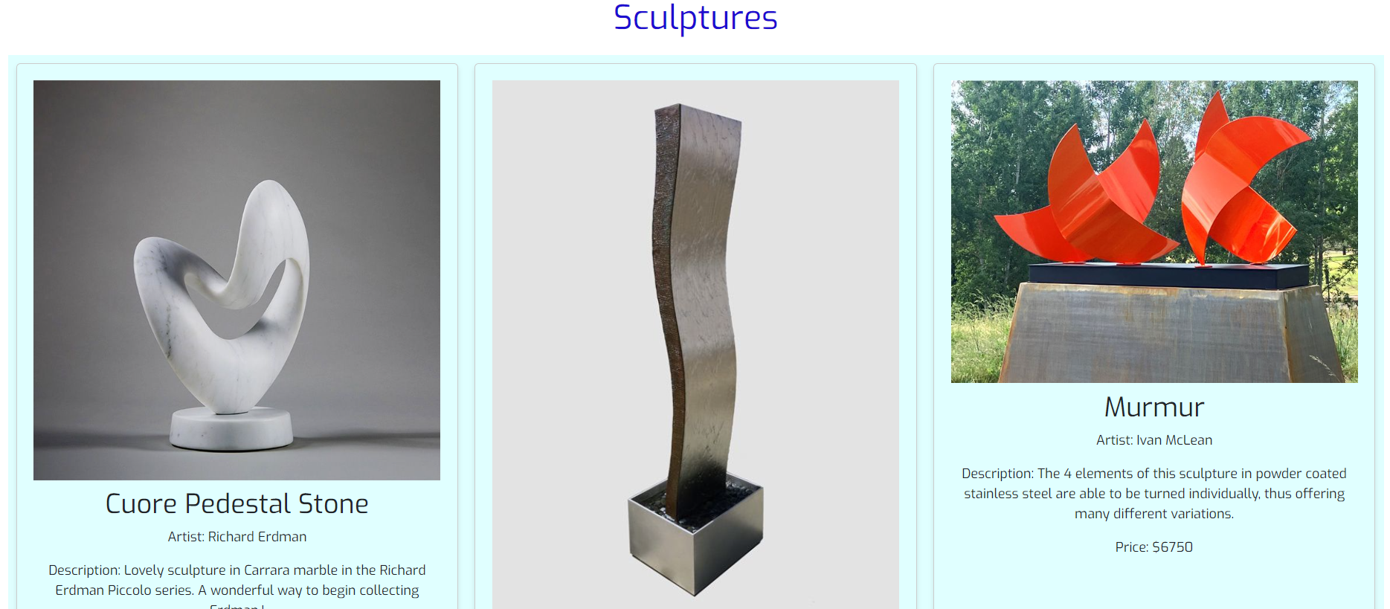
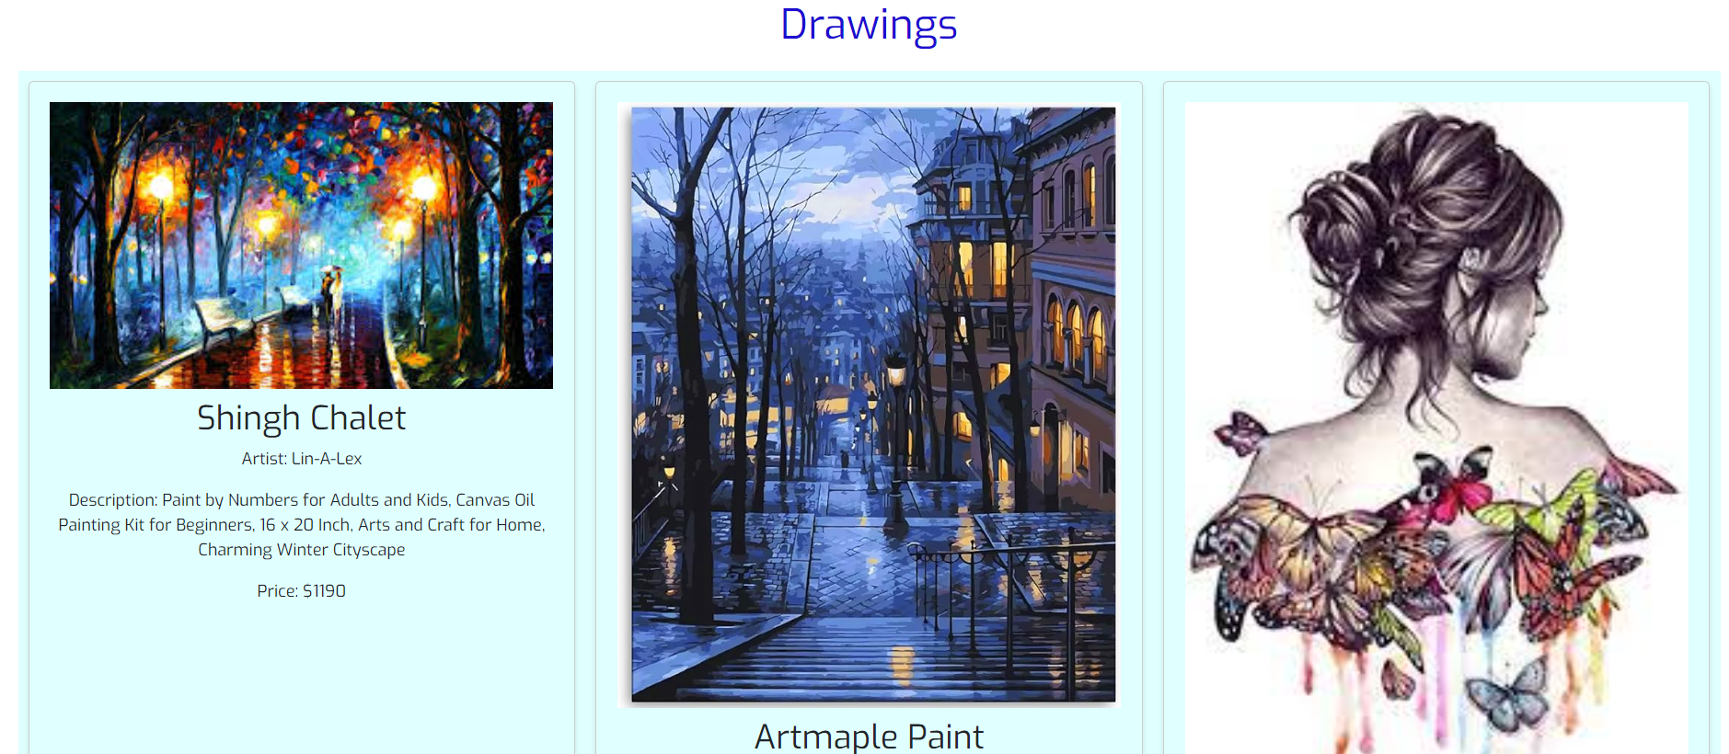

Slide 18

What we have accomplished!
As a cohesive team effort, we've successfully developed 90% of the front-end part of our web application.
Additionally, we've crafted visually appealing Navbars that creatively showcase collaborative images of the artworks contributed by our talented artists.
Completed the front-end part like Landing page
Login pages for customer and artist
Artist Home page
Customer Home page
Artist Upload art form page
User Profile page
Navigation Bar
Logo
Footer
Every separate page for each type of art

Slide 19
SPRING 2024 PLAN
FUNCTIONALITIES | TIME PLAN
Working with Login & Register pages | January 8th - January 22nd
Working with Artist Home page | January 23rd - February 5th
Working with Artist art upload page | February 6th - February 19th
Working with Customer Home Page | February 20th - March 5th
Working with Bid functionality for Customer | March 6th - March 19th
Implementing the cart functionality | March 20th - April 2nd
Working with Chat Functionality between the artist and Customer | April 3rd - April 16th
Hosting on production server | April 17th - April 30th
Integration of front end
with backend.
Chat functionality
Hosting
Database Management

Slide 20
THANK YOU

